Slide 1
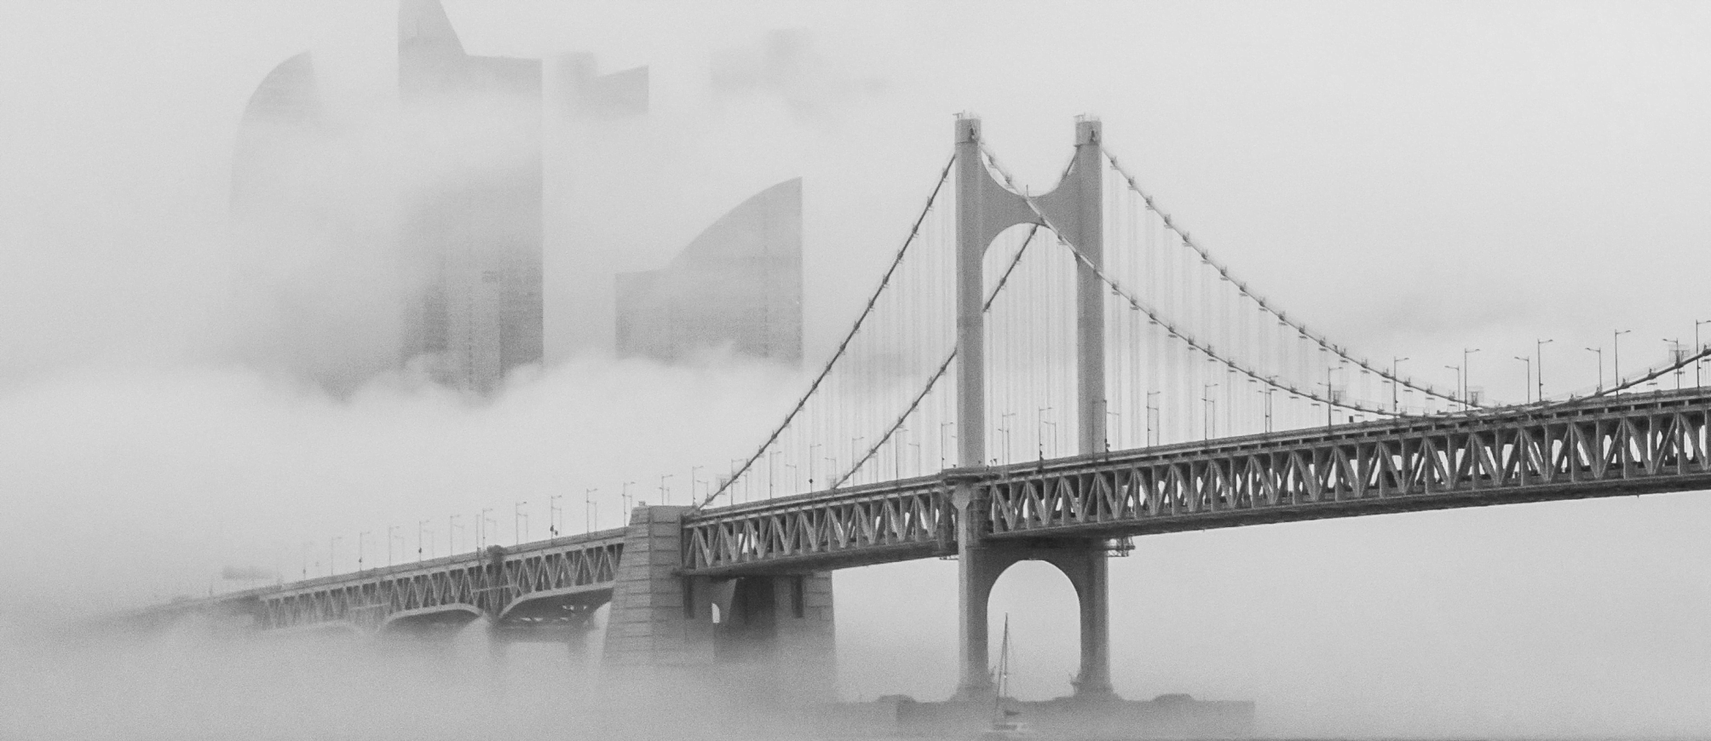

Movie Rating Classification and Recommendation
STOR 565 Project
Group 13: Manhui Zhu, Chengze Xie

Slide 2

01
CONTENT
02
03
04
Dataset & EDA
Rating Classification
Movie Recommendation
Future Work

Slide 3

Dataset
This dataset is from Kaggle website. It contains 5043 movies spanned across 100 years in 66 countries.
It contains 28 variables, and 5043 observations. The dataset has 12 categorical variables and 16 numerical variables.
Movie IMDB Dataset
We use the "imdb_score" (variable: number from 1-10) to divides all observations in 4 class:
[0, 3): bad,
[3, 6): fair,
[6, 8): good,
[8, 10]: excellent.
After cleaning the dataset, we have 3711 observations and 15 variables. We split the data into training set and testing set, and the ratio is 8:2.

Slide 4
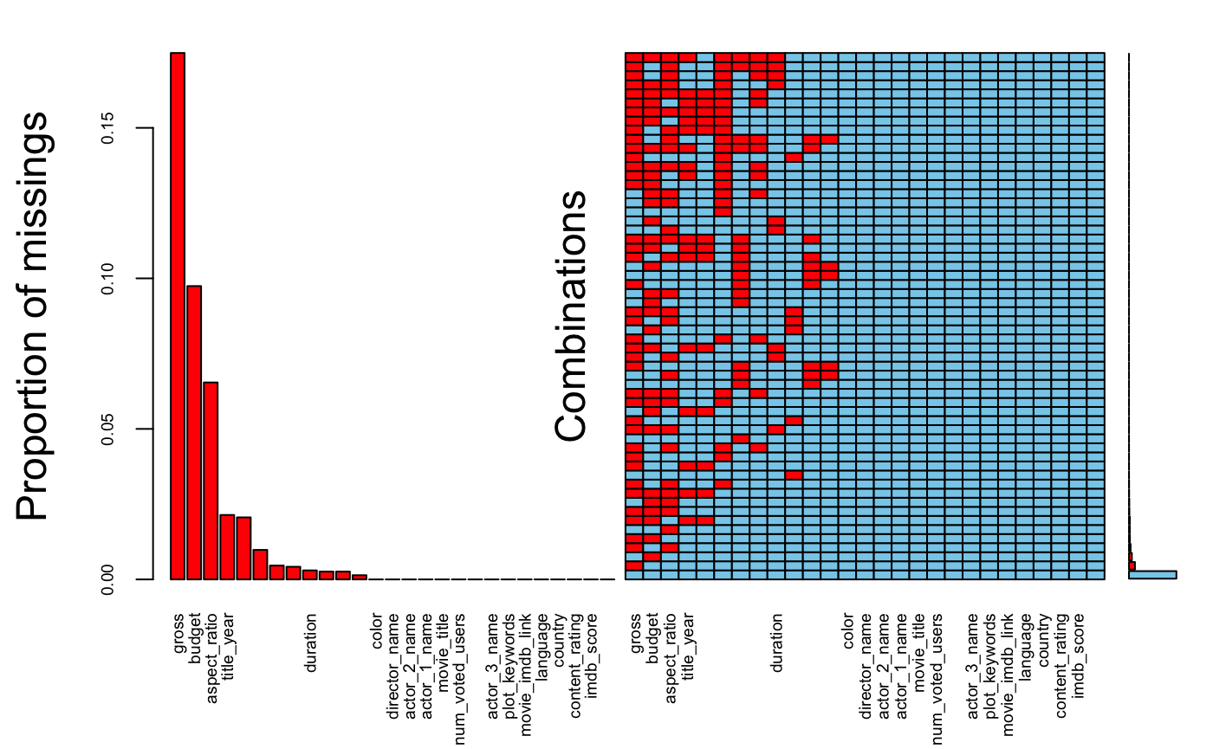
Data Cleaning
Dispose the Missing Values and some Categorical Variables
Remove the 45 duplicated rows
Delete the rows with NA in variable "gross" and variable "budget"
"movie_title": remove the white spcae and special character "Â"
"aspect_ratio": imdb_score for 3 different values are similar, remove the variable
"color": 96% of observations are colored movie, remove the variable
"language": 95% of observations are english movie, remove the variable
"country": group into 3 values: USA, UK, Others
"title_year": remove the movie released before 1980
Notes:
1)Replace the 0 values with column average for some variables.
2) Aspect ratio: We find that the most common aspect_ratio are 1.85 and 2.35. For analysis convenience, we group other ratio together. But first we need to replace NA with 0 first, and calculate the mean of the IMDB score for the current 3 different groups of aspect_ratio.
3) content rating: The new ratings system began with four categories: G (general audiences), M (mature audiences, changed in 1969 to PG, parental guidance suggested), R (restricted, no children under 17 allowed without parents or adult guardians), and X (no one under 17 admitted). Therefore, M=GP=PG, and X=NC-17. We replace M and GP with PG, replace X with NC-17, because these two are what we use nowadays. We want to replace “Approved”, “Not Rated”, “Passed”, “Unrated” with the most common rating “R”.

Slide 5
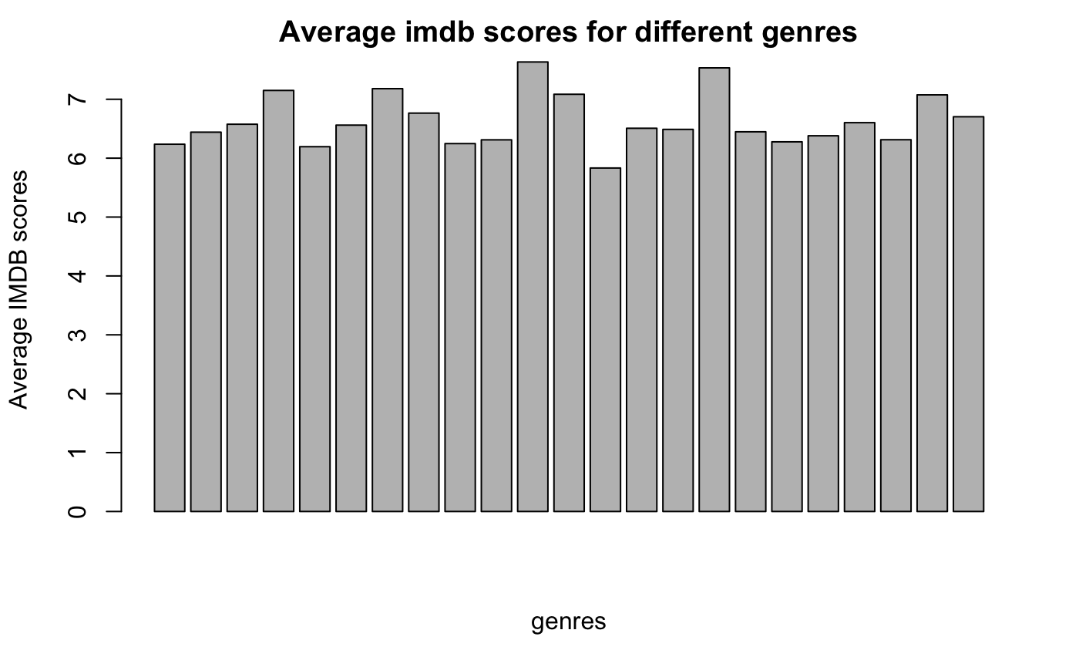
EDA: Is genres important to rating?
We calculate mean imdb_score for different genres. They are all in the range of 6-8.
Not matter.
Remove "genres"
Notes:
Each observations have various genres. We first divide the string and save substring along with its corresponding IMDB score in the other data frame. Then separate different genres into new column and set factor of them.

Slide 6
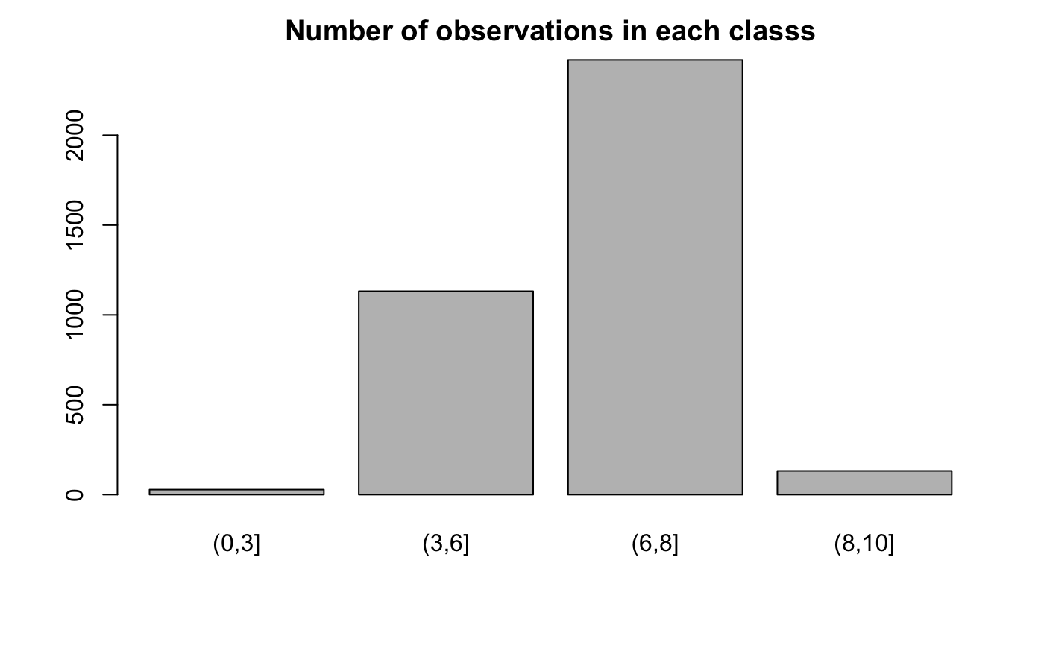
EDA: Balanced or Unbalanced

Slide 7
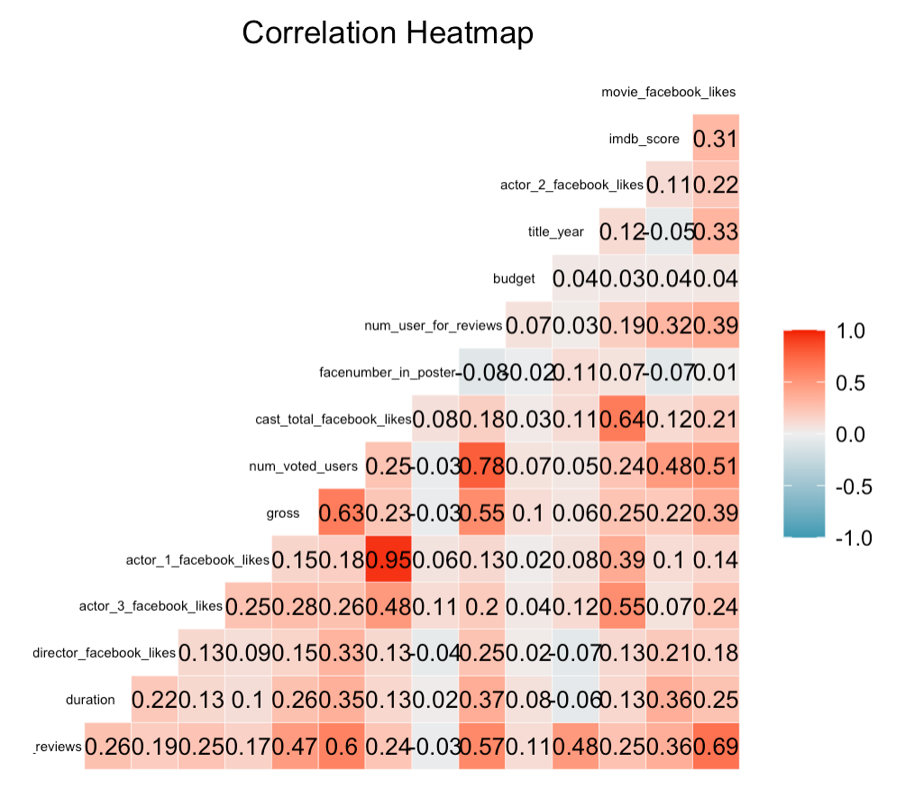
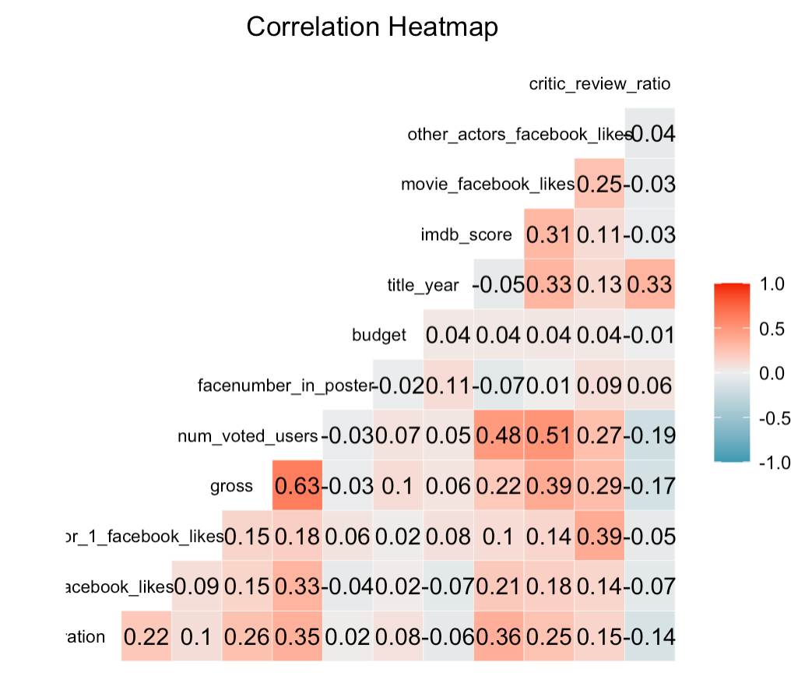
EDA: Are variables correlated?
Notes:
Based on the heatmap, we can see some high correlations (greater than 0.7) between some predictors.
According to the highest correlation value 0.95, we find actor_1_facebook_likes is highly correlated with the cast_total_facebook_likes, and both actor2 and actor3 are also somehow correlated to the total. So we add up actor 2 and 3 facebook likes into other actors facebook likes and finally modify them into two variables: actor_1_facebook_likes and other_actors_facebook_likes.
There are high correlations among num_voted_users, num_user_for_reviews and num_critic_for_reviews. We want to keep num_voted_users and take the ratio of num_user_for_reviews and num_critic_for_reviews.

Slide 8
Rating Classification
01
02
03
04
Stratify the predictor space into small regions and use the mode (classification) of the response values for observations in region as the predicted response for that region
Using the bootstrap, we get many deep and unpruned trees, and we take the average of these trees to reduce the variance.
Random choose m predictors from original dataset to form bootstrap samples. Then taking the average of these trees to reduce the variance.
Using the K nearest neighbors, the class label is assigned to the observation based on the majority class (vote) of observation around it.
Classification Tree
Bagging
Random Forest
KNN

Slide 9
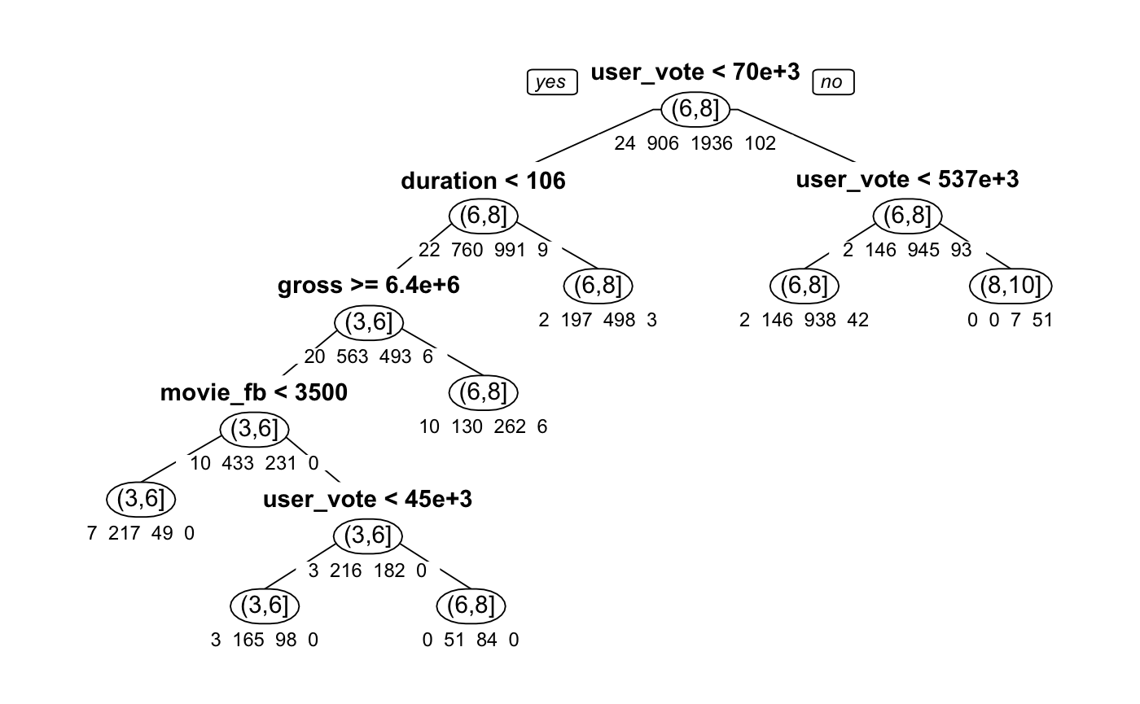
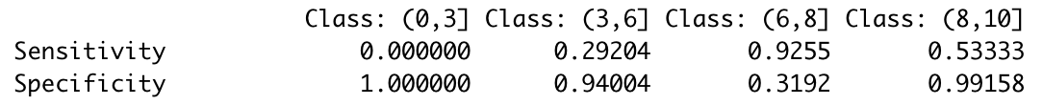
Classification Tree (Unpruned)
Overall accuracy:
0.712

Slide 10
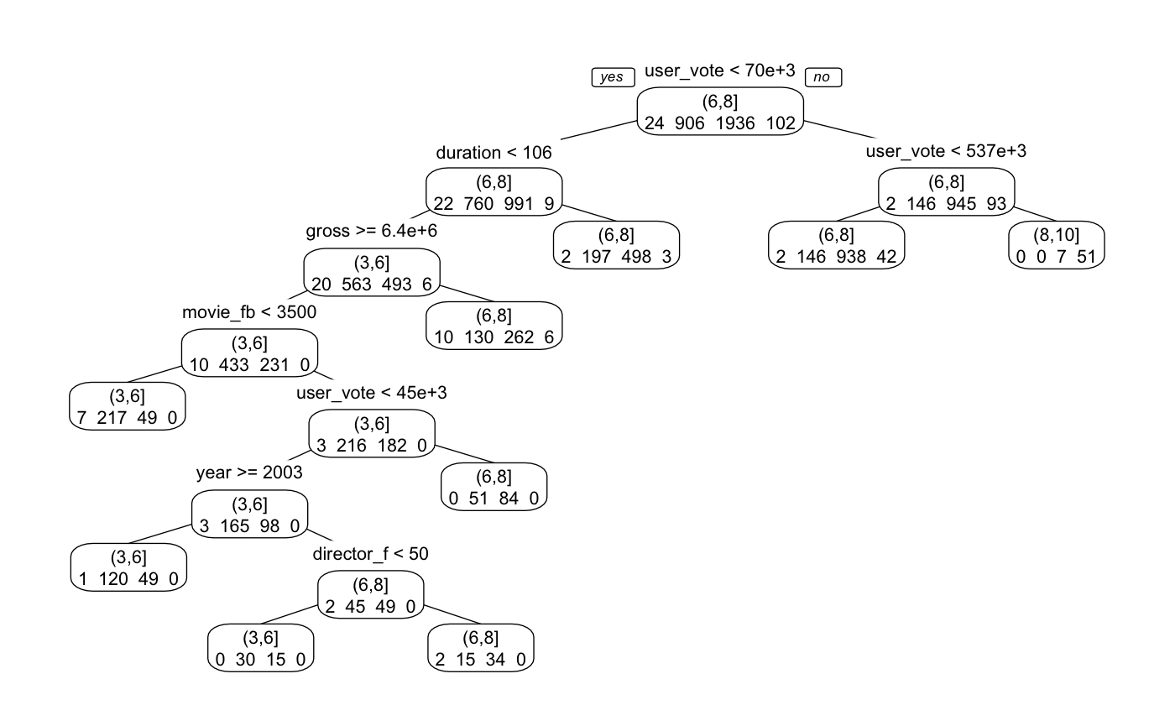
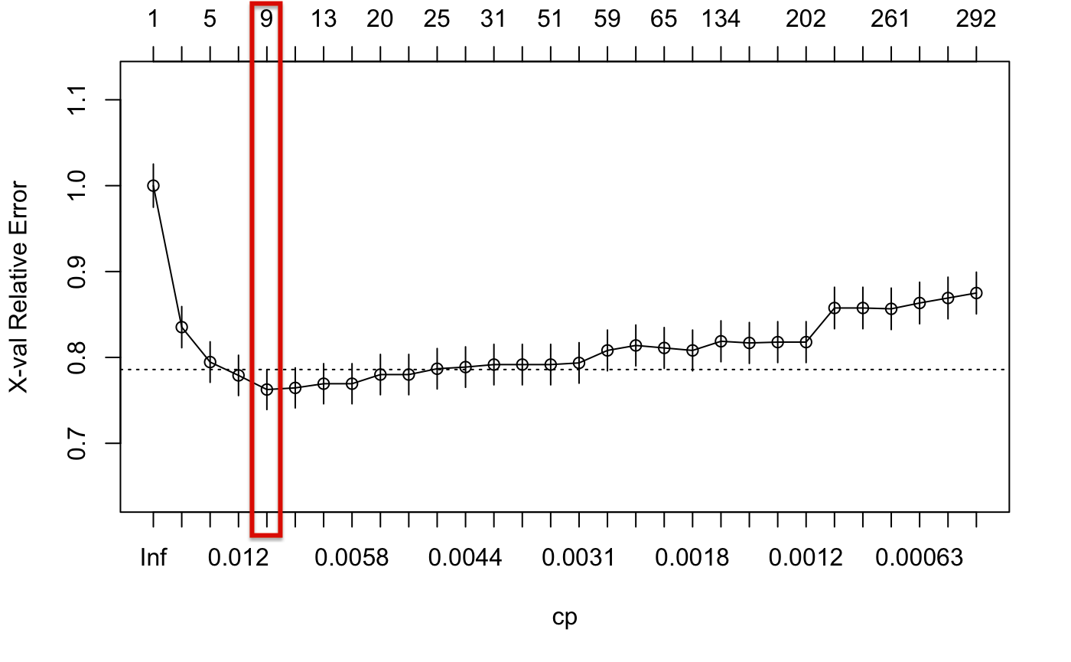
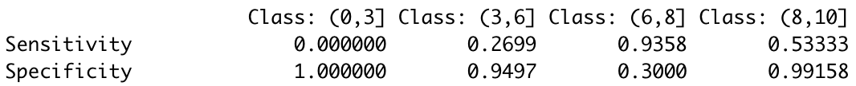
Classification Tree (Pruned)
Overall accuracy:
0.712

Slide 11
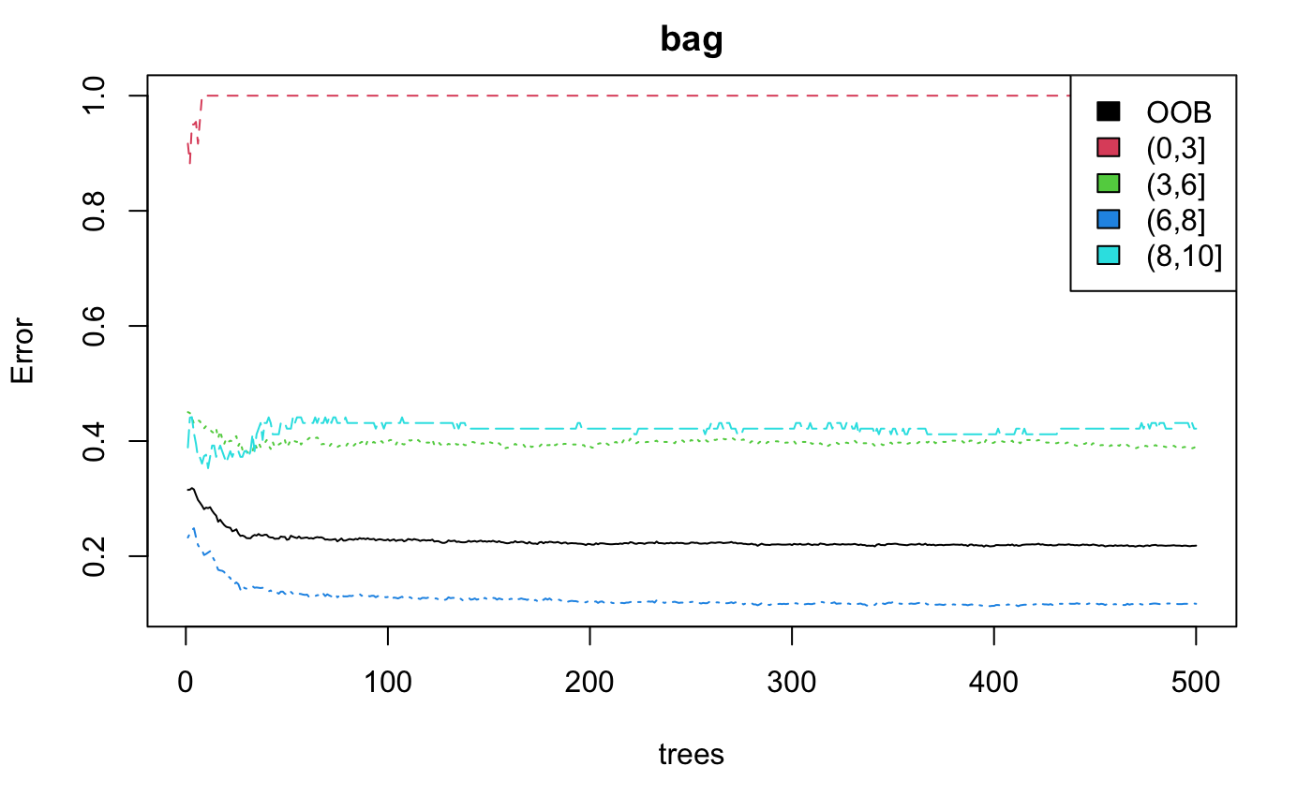
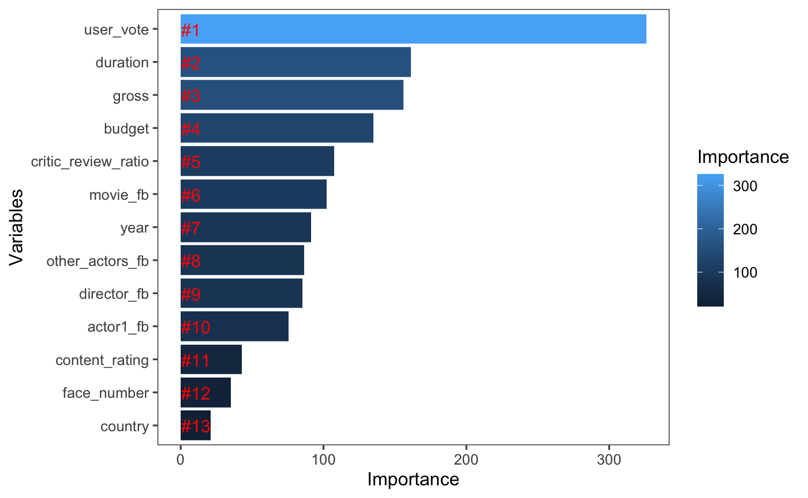
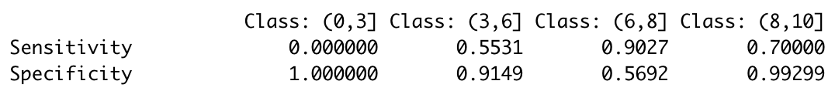
Bagging
Overall accuracy:
0.783

Slide 12
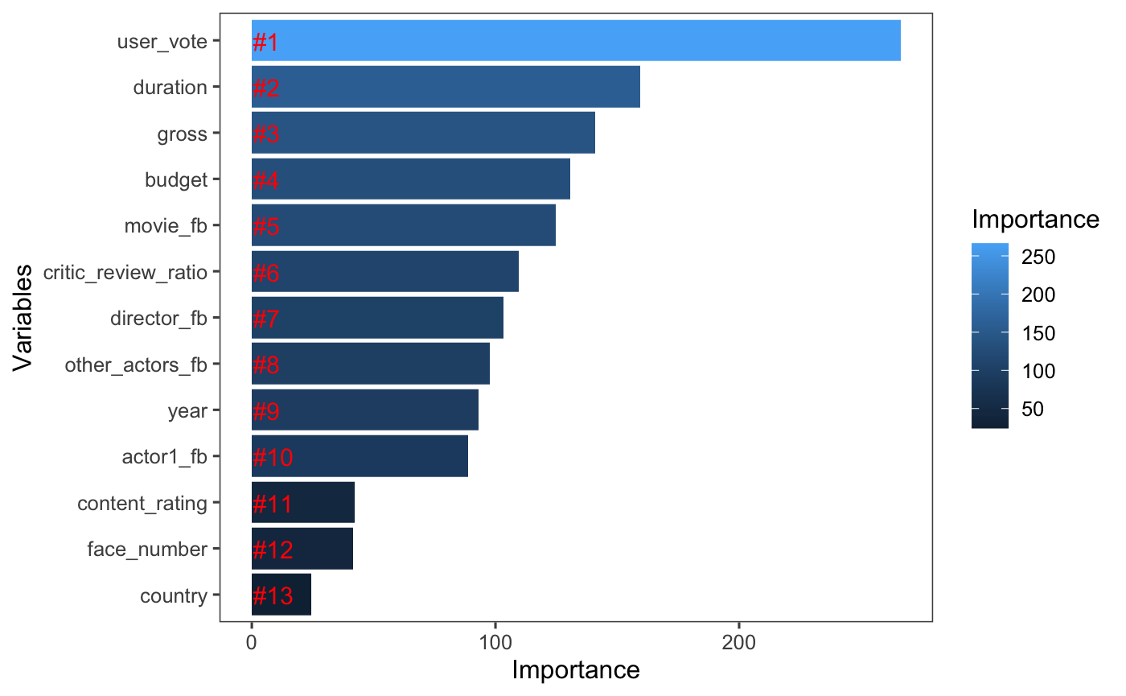
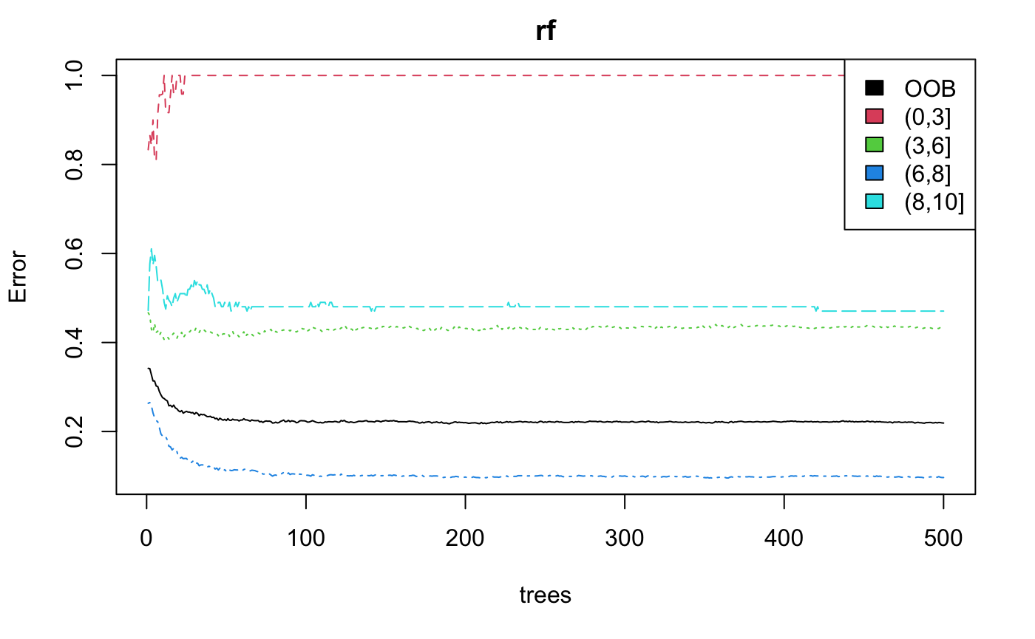
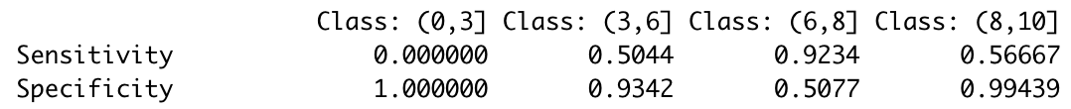
Random Forest
Overall accuracy:
0.777

Slide 13
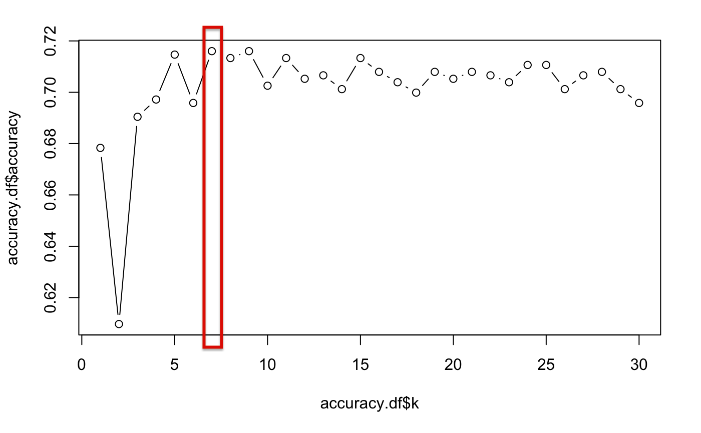
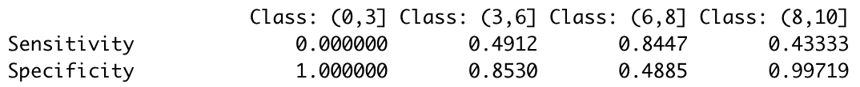
K-Nearest Neighbors
Overall accuracy:
0.716
Notes:
We try different k parameters from 1 to 30, and we plot the test accuracy for model with different k, we find that when k = 7, the test accuracy is the highest.

Slide 14
Overall Result
Method | Test Accuracy
Classification Tree (Unpruned) | 0.712
Classification Tree (Pruned) | 0.712
Bagging | 0.783
Random Forest | 0.777
KNN | 0.716

Slide 15
Recommendation Engine
Simple Recommender
Content Based Recommender
Collaborative Filtering

Slide 16
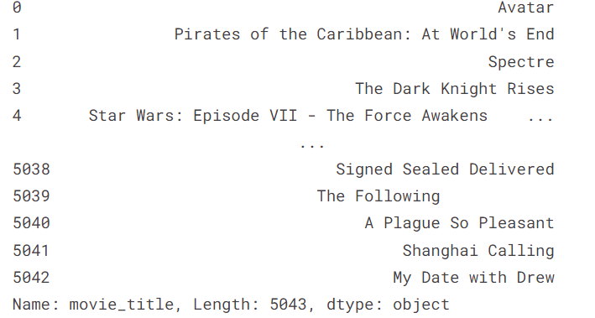
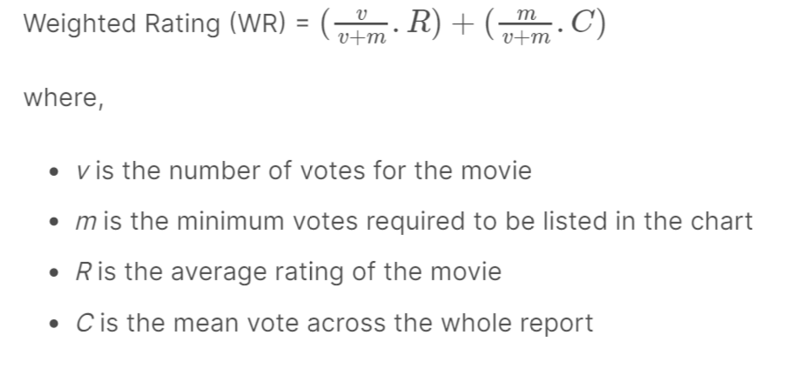
Simple Recommender
Using IMDB Weighted Rating to rank all movies

Slide 17
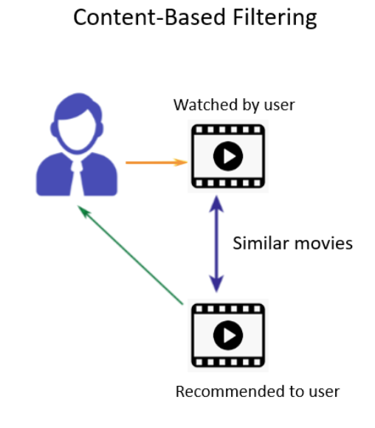
Content Based Recommender
Guess the features or behavior of a
user given the item’s features
Not require other users' data
during recommendations

Slide 18
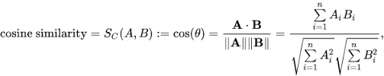
Cosine Similarity
Using the Cosine Similarity to calculate a numeric quantity that denotes the similarity between two movies.

Slide 19
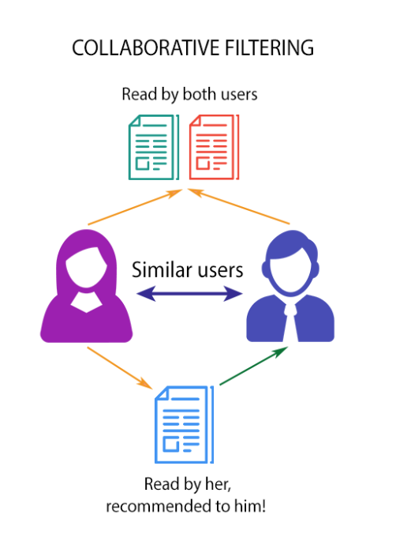
Collaborative Filtering
Capturing tastes and providing recommendations across their
previous behavior.
Using SVD to minimize RMSE

Slide 20
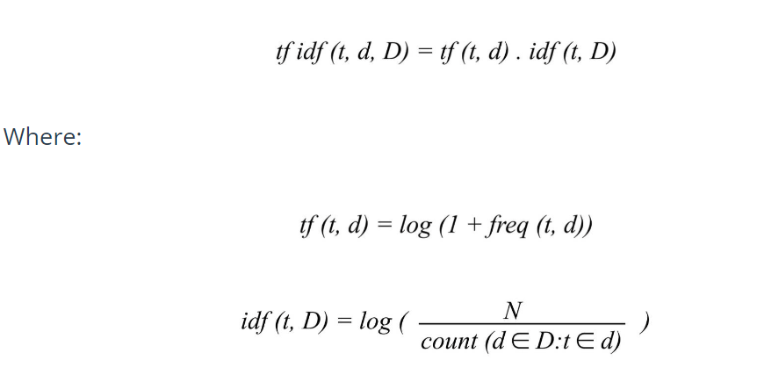
TF-IDF
TF is simply the frequency of a word in a document.
IDF is the inverse of the document frequency among the whole corpus of documents.

Slide 21
Implement Content Based Recommender
Select all Categorical variables to form a new dataframe
Vectorizing data and find tf-idf by Sklearn library
Using linear_kernel, cosine_similarity to calculate the similarity matrix
Calculate the 75th percentile of the distribution of rating
Sorting movies, filtering movies that have a rating lower than 7.2(the 75th percentile of rating)
Output the top 10 recommendation

Slide 22
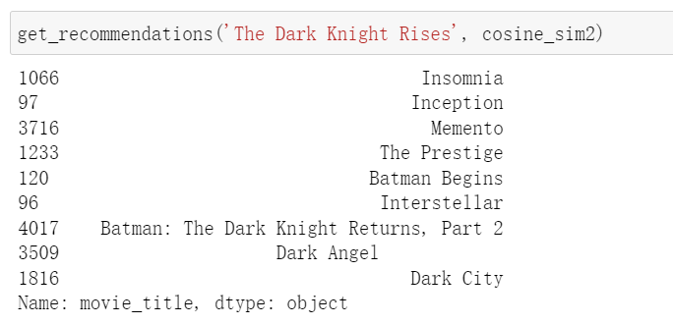
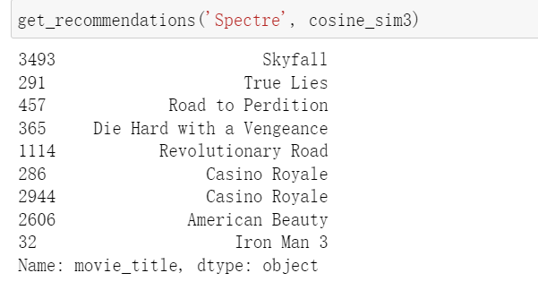
Content Based Recommender example

Slide 23
Implement Collaborative Filtering
Loading another dataset that contains users’ information
Only selecting User_id, ratings, and Movie_id to form a dataset
Using a build-in SVD method of Surprise library to minimize RMSE ( got RMSE of 0.8963, which is really good!)
Training model on the dataset
Output recommendation of a given user

Slide 24
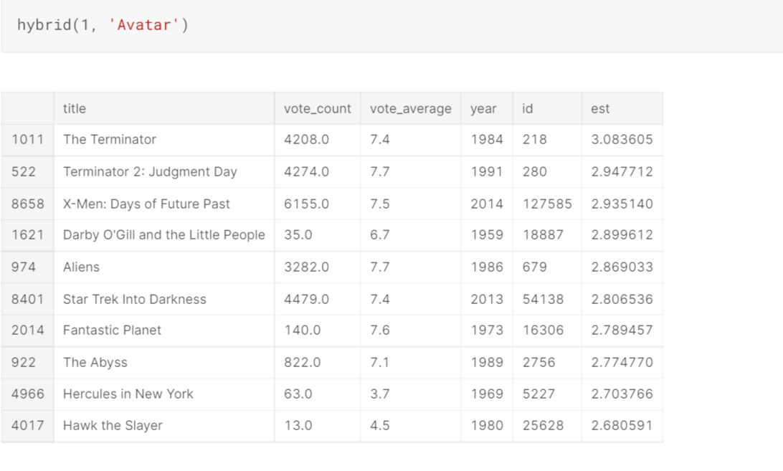
Collaborative Filtering example

Slide 25
Future Work
Solve the unbalanced problem for the dataset, may try to oversample the bad movie (imdb_score in the range of [0,3)) and the excellent movie (imdb_score in the range of [8,10]).
Try some other dataset by using our recommender engine
Try some SOTA methods to see their performance on our dataset
Develop a user interface to improve users’ experience
Test our algorithm’s performance by design a questionnaire such that users can tell us whether our prediction really give them a good recommendation.

Slide 26
Thank you!

